Slide 1
WALES ANTI-SLAVERY CHILD SEXUAL EXPLOITATION AWARENESS COURSE
Notes:
Sign in / name badges
Welcome Introduce myself and course

Slide 2
HOUSEKEEPING
Fire Safety
Toilets
Mobile Phones
Timings and breaks
Smoking.
Notes:
TRAINER TO:
Check with venue if there are any fire drills planned for that day and where the fire exits and assembly points are. Also the toilets.
Ask delegates to switch off mobile phones or put on silent. If calls need to be taken then they should leave the room.
Give a rough idea of what time breaks will be and how long they will get.
Check with the venue where delegates must go to smoke.

Slide 3


Slide 4
GROUP AGREEMENT
Listen and respect what others have to say
One person talking at a time
Share experiences and views
Recognise the sensitive nature of the subject
Keep focused
Respect confidentiality
If you don’t understand ask!
Notes:
Reminder that course attendee’s should only use professional examples not personal ones.
Only one person talking at a time so people don’t miss vital information. Also that no question is ‘stupid’ because if your thinking it, so is someone else in the room.
Course attendee’sl come from various backgrounds but try to anonymise when talking about experiences.
Remind that if they disclose something it will need to be passed on.

Slide 5
OBJECTIVES
By the end of the course delegates will be able to:
Identify that Child Sexual Exploitation is happening and that a young person is at risk
Explain your role and responsibility in line with the All Wales Guidance on Safeguarding Children & Young People at risk of abuse through Sexual Exploitation
Recognise the link between Child Sexual Exploitation and Slavery
Demonstrate the assessment of a child or young person at risk using the Seraf Risk Assessment Framework (SERAF) tool

Slide 6
WELSH GOVERNMENT GUIDANCE – SAFEGARDING CHILDREN FROM SEXUAL EXPLOITATION
Notes:
Welsh Government Guidance - Safeguarding Children and Young People from Sexual Exploitation Supplementary to Safeguarding Children: Working Together Under the Children Act 2004
(2011)
Ask delegates how aware they are of this guidance?

Slide 7
MODERN SLAVERY STRATEGY
In Wales the strategy to tackle slavery is being delivered in line with the Home Office Modern Slavery Strategy
Pursue
Prevent
Protect
Prepare
Notes:
In Wales the strategy to tackle slavery is being delivered in line with the Home Office Modern Slavery Strategy:
Pursue
‘Prosecute and disrupt individuals and groups responsible for slavery’
Prevent
‘Prevent people from engaging in slavery’
Protect
‘Strengthen safeguards against slavery by protecting vulnerable people from exploitation and increasing awareness of and resilience against this crime’
Prepare
‘Reduce the harm caused by slavery through improved victim identification and enhanced support’
Link to the Modern Slavery Strategy: https://www.gov.uk/.../Modern_Slavery_Strategy_FINAL_DEC2015.pdf

Slide 8
CAUGHT IN TRAFFICK
DVD
Notes:
Made by the Merthyr & RCT Young people’s human trafficking group.

Slide 9
THE GROOMING PROCESS

Slide 10
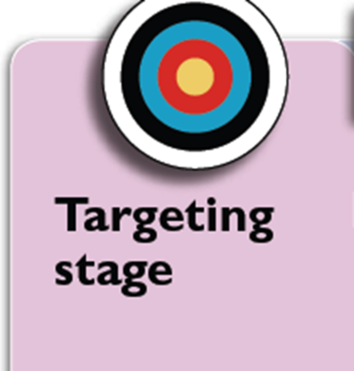
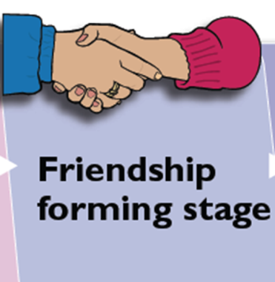

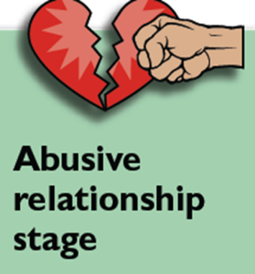
THE GROOMING STAGES:
TARGETING
FRIENDSHIP FORMING
LOVING RELATIONSHIP
ABUSIVE RELATIONSHIP.
Notes:
TARGETING - The groomer will look for a young person/group and approach them and possibly
offer something, e.g. a cigarette, drink, someone to talk to etc.
FRIENDSHIP FORMING - Spends time, gives compliments, offers favours like lifts,
a place to stay
LOVING RELATIONSHIP - A sexual relationship begins and the groomer presents
as a loving, caring person
TAKING CONTROL - Gradually ties to others are destroyed, the groomer may involve
YP in illegal activities and violence, threats and coercion can be used
ABUSIVE RELATIONSHIP - The groomer has created a ‘willing victim’. The young person may
be forced to have sex with others and/or be filmed performing sexual acts.
Handout on grooming indicators

Slide 11
CURRENT TRENDS
Peer led exploitation
Use of technology
Organised exploitation
Internal trafficking
Older boyfriend/’Loverboy model’
Survival sex
Party scene
Identity
Commodity
Notes:
The following examples (based on the Barnardo’s 2011 report, Puppet on a string – The urgent need to cut children free from sexual exploitation) describe the different types of exploitation offenders use and how children can be coerced.
Inappropriate relationships
These usually involve one offender who has inappropriate power or control over a young person (physical, emotional or financial). One indicator may be a significant age gap. The young person may believe they are in a loving relationship.
Boyfriend model
Here the offender befriends and grooms a young person into a ‘relationship’ and then coerces or forces them to have sex with friends or associates. The boyfriend may be significantly older than the victim, but not always.
Peer-on-peer exploitation
This refers to situations where young people are forced or coerced into sexual activity by peers or associates. Sometimes this can be associated with gang activity but not always.
Gang-associated CSE
A child or young person can be sexually exploited by a gang, but this is not necessarily the reason why gangs are formed. Types of exploitation may include using sex as a weapon between rival gangs, as a form of punishment to fellow gang members and/or a means of gaining status within the hierarchy of the gang.
Organised/networked sexual exploitation or trafficking
Young people (often connected) are passed through networks, possibly over geographical distances, between towns and cities where they may be forced/coerced into sexual activity with multiple men. Often this occurs at ‘parties’, and young people who are involved may recruit others into the network. Some of this activity is described as serious organised crime and can involve the organised ‘buying and selling’ of young people by offenders. Organised exploitation varies from spontaneous networking between groups of offenders, to more serious organised crime where young people are effectively ‘sold’

Slide 12
WHAT IS CHILD SEXUAL EXPLOITATION?
It’s a major child protection issue for communities across the UK.
Is illegal activity by people who have power over young people and use it to sexually abuse them.
Can involve a broad range of exploitative activity, from seemingly ‘consensual’ relationships and informal exchanges of sex for attention, accommodation, gifts or cigarettes, through to very serious organised crime.
Notes:
Highlight here that the UN Convention on the rights of the child clearly states that a child is anyone who has not yet reached their 18th birthday.
Involves exploitative situations, contexts and relationships where young people (or a third person or persons) receive 'something' (e.g. food, accommodation, drugs, alcohol, cigarettes, affection, gifts, money) as a result of performing, and/or others performing on them, sexual activities.
Can occur through ICT without the child's immediate recognition or consent, for example posting sexual images on the internet/mobile phones.
In all cases those exploiting the child/young person have power over them by virtue of their age, gender, intellect, physical strength and/or economic or other resources

Slide 13
CHILD SEXUAL EXPLOITATION IS….
Child sexual exploitation is the coercion or manipulation of children and young people into taking part in sexual activities. It is a form of sexual abuse involving an exchange of some form of payment which can include money, mobile phones and other items, drugs, alcohol, a place to stay, ‘protection’ or affection. The vulnerability of the young person and grooming process employed by perpetrators renders them powerless to recognise the exploitative nature of relationships and unable to give informed consent.
AWCPP 2008
Notes:
Child exploitation often referred to as CSE. Remind there is also an ACPO definition.
The manipulation or ‘grooming’ process involves befriending children, gaining their trust, and often feeding them drugs and alcohol, sometimes over a long period of time, before the abuse begins. The abusive relationship between victim and perpetrator involves an imbalance of power which limits the victim’s options. It is a form of abuse which is often misunderstood by victims and outsiders as consensual. Although it is true that the victim can be tricked into believing they are in a loving relationship, no child under the age of 18 can ever consent to being abused or exploited. (Barnardo’s, 2012).
Child sexual exploitation can manifest itself in different ways. It can involve an older perpetrator exercising financial, emotional or physical control over a young person. It can involve peers manipulating or forcing victims into sexual activity, sometimes within gangs and in gang-affected neighbourhoods, but not always. Exploitation can also involve opportunistic or organised networks of perpetrators who may profit financially from trafficking young victims between different locations to engage in sexual activity with multiple men (Barnardo’s, 2011).
This abuse often involves violent and degrading sexual assaults and rape. The Children’s Commissioner’s report on sexual exploitation by gangs and groups found that oral and anal rape were the most frequently reported types of abuse. Experts agree that these types of abuse are particularly humiliating and controlling, and, as such, may be preferred by those who exploit vulnerable young people (Berelowitz et al, 2012). Exploitation can also occur without physical contact when children are persuaded or forced to post indecent images of themselves online, participate in non-contact sexual activities via a webcam or smartphone, or engage in sexual conversations on a mobile phone (DfE, 2011).
Technology is widely used by perpetrators as a method of grooming and coercing victims, often through social networking sites and mobile devices (Jago et al, 2011). This form of abuse usually occurs in private, or in semi-public places such as parks, cinemas, cafes and hotels. It is increasingly occurring at ‘parties’ organised by perpetrators for the purposes of giving victims drugs and alcohol before sexually abusing them (Barnardo’s, 2012).

Slide 14
GREY AREA FOR 16/17 YEAR OLDS?
The law also gives extra protection to young people who are 16/17 years old. It is illegal to:
take, show or distribute indecent photographs
pay for or arrange sexual services
for a person in a position of trust (for example, teachers, care workers) to engage in sexual activity with anyone under the age of 18.
Notes:
These come from the Sexual Offences Act 2003

Slide 15
CONSENT
The fact that a young person is 16 or 17 years old and has reached the legal age of consent should not be taken to mean that they are no longer at risk of sexual exploitation.
These young people are defined as children under the Children Act 1989 and 2004, and they can still suffer significant harm as a result of sexual exploitation.
Their right to support and protection from harm should not, therefore, be ignored or downgraded by services because they are over the age of 16, or are no longer in mainstream education.
College of Policing
Notes:
Section 74 states that:"For the purposes of this Part, a person consents if he agrees by choice, and has the freedom and capacity to make that choice."^{[ Sexual offences act 2003}

Slide 16
HOW MIGHT IT HAPPEN?
Abuse may happen through:
exchange of sexual activity for some form of payment
abuse through the production of indecent images and/or any other indecent material involving children whether photographs, films or other technologies
abuse through grooming whether via direct contact or the use of technologies such as mobile phones and the internet
abuse through slavery for sexual purposes

Slide 17
Vulnerability
being susceptible to harm or injury
The offences are about Power, Control and Money. It requires one or more offender to abuse or exploit one or more victims
Notes:
There are many ways that a child or adult can be Vulnerable. This is not just about Modern Slavery, but also Child Sexual Exploitation, Domestic Abuse, Female Genital Mutual, Forced Marriage, Mental health, Prostitution and all aspects of Public Protection
The offences are about Power, Control and Money. It requires one or more offender to abuse or exploit one or more victims

Slide 18
power and control can be driven by a number of factors - look out for
What is the relationship between the offender and victim?
(Parental / Family / work related)
What are the circumstances that contribute to a person being a victim?
(Age / Mental health / Addictions / Social Ability)
What does an offender gain from the relationship?
(Control / Money / Belief Systems)
How is a Victim Controlled?
(Threats or Violence / Money / Addictions / Moral obligation)

Slide 19
If you have contact with the Public…
Be curious and question relationships if you suspect anything of concern
Look to gain trust and confidence
Identify the risk
Bring a victim to safety

Slide 20
Simple message
Look, Understand and Help
All Public Services
Private Sector
Third Sector

Slide 21
SLAVERY IS:
The recruitment, transportation, transfer, harbouring or receipt of persons, by means of the threat or use of force or other forms of coercion, of abduction, of fraud, of deception, of the abuse of power or of a position of vulnerability or of the giving or receiving of payments or benefits to achieve the consent of a person having control over another person, for the purpose of exploitation.
Exploitation shall include, at a minimum, the exploitation of the prostitution of others or other forms of sexual exploitation, forced labour or services, slavery or practices similar to slavery, servitude or the removal of organs.
Notes:
Highlight to delegates that this protocol is what is used for consistency in both the Welsh Government practice guidance & the All Wales Procedures.
It would be a good idea to have this to hand every time you complete an NRM form to ensure you have covered all the requirements for a trafficked victim.
Talk about “into UK”, “out of UK” & “around the UK” – from one area or city to another – known as Internal Trafficking or could even be from one room or floor to another.
Usually for those coming into the country, it is for a job they have applied for but turns out to be something completely different when they arrive.
While many organisations have different work streams or departments, the traffickers have a person they regard as a commodity, who they use and abuse at will. They do not simply categorise any single facet, but will make use of the victim however they see fit.
It is a fact that traffickers will ‘coach’ victims not to engage with ‘the Authorities’ – Police and Social Services. The fact that many victims come from under developed areas where corruption is rife, is often used by the traffickers to ensure that they are reluctant to engage with Police or SSD.

Slide 22
TYPES OF EXPLOITATION
These are wide ranging and often include the following types of conduct:
Sexual Exploitation
Forced Labour Exploitation
Criminal Exploitation
Domestic Servitude
Enabling others to acquire benefit
Organ harvesting
Notes:
Sexual - frequently through prostitution where victims are placed into off-street brothels, forced to see many clients, and receive either little or no money.
Forced labour - where victims are forced to work very long hours and hand over all of their wages to their traffickers or controllers, e.g. domestic situations as nannies or maids, sweatshop factories, construction sites, farm work, paving/ tarmacking
Criminal – drugs, cannabis farming, organised crime, begging, benefit fraud, sshoplifting/Theft, Credit card/ATM fraud, Selling Stolen Goods, DVD Pirating and Sales
Domestic Servitude - victims who live and work in households where they are forced to work through threats of serious harm and physical and sexual assaults.
Enabling others to acquire benefit - this can include but is not restricted to money from state financial assistance such as child benefit or unemployment benefit
Organ harvesting - where victims are trafficked in order to sell their body parts and organs for transplant; eggs, kidneys, eyes (China)
Children - children are amongst the most vulnerable victims; sometimes they are sold into forced labour or domestic work through debt bondage by family members where they are vulnerable to sexual or physical abuse.

Slide 23
SEXUAL OFFENCES ACT 2003
Introduced a range of offences that recognised the grooming, coercion and control of children.
section 14 arranging or facilitating a child sex offence (child under 16)
section 15 meeting a child following sexual grooming (child under 16)
section 47 paying for the sexual services of a child
section 48 causing or inciting child prostitution or pornography
section 49 controlling a child prostitute or a child involved in pornography
section 50 arranging or facilitating child prostitution or pornography
Section 59A replaced by Modern Slavery Act 2015.
Notes:
The Act includes three broad categories of sexual offences against children.
Offences against children under the age of 13 (ss 5 to 8)Sexual activity with a child under the age of 13 is an offence regardless of consent or the defendant’s belief of the child’s age. The offences are:
rape
assault by penetration
sexual assault
causing or inciting a child under 13 to engage in sexual activity.
The offences carry a maximum sentence of life imprisonment or 14 years’ imprisonment, depending on which offence applies.
Offences against children under the age of 16 (ss 9 to 15)These offences apply regardless of whether the child consented to the sexual activity but, unlike the offences relating to children under 13, an offence is not committed if the defendant reasonably believed that the victim was 16 years or over. The offences are:
sexual activity with a child
causing or inciting a child to engage in sexual activity
engaging in sexual activity in the presence of a child
causing a child to watch a sexual act
arranging or facilitating the commission of a child sex offence
meeting a child following sexual grooming (under s 15 an offence is committed if an adult meets or communicates with a child on at least two previous occasions, and then meets the child, arranges to meet the child or (the adult or child) travels for such a meeting, where the adult intends to commit a sexual offence).
These offences carry a minimum sentence of 10 or 14 years’ imprisonment, depending on which offence applies. Where the offender is under 18, the maximum sentence is 5 years’ imprisonment. If any of these offences is committed against a child under 13, the defendant’s belief of the age of the child is irrelevant.

Slide 24
Notes:
Offences against children under the age of 18There are a number of sexual offences in the Act that apply to all children under the age of 18. These include sexual offences where there is abuse of a position of trust (ss 16 to 24) and familial child sex offences (ss 25 to 29).
The Act also provides for offences specifically to tackle the use of children in the sex industry, where a child is under 18 (ss 47 to 50). These offences are:
paying for sexual services of a child
causing or inciting child prostitution or pornography
controlling a child prostitute or a child involved in pornography
arranging or facilitating child prostitution or pornography

Slide 25
SERIOUS CRIME ACT 2015
Part 5: Protection of children and others
Updating and clarifying the offence of child cruelty in section 1 of the Children and Young Persons Act 1933
Introducing a new offence of sexual communication with a child
Amends the Sexual Offences Act 2003 to remove anachronistic references to child prostitution and pornography
Created a new offence making it illegal to possess paedophile manuals
New provisions on tackling FGM
Tackling domestic abuse by criminalising patterns of repeated or continuous coercive or controlling behaviour
Notes:
Serious Crime Act 2015Part 5: Protection of children and others
9. Part 5 makes a number of changes to the civil and criminal law to enhance the protection of children and others, namely:
a) Updating and clarifying the offence of child cruelty in section 1 of the Children and Young Persons Act 1933, in particular, to make it explicit that the offence covers conduct which is likely to cause psychological suffering or injury as well as physical harm. This Part also modernises some of the language in section 1 of the 1933 Act.
b) Introducing a new offence of sexual communication with a child. This would criminalise an adult who communicates with a child for the purpose of obtaining sexual gratification, where the communication is sexual or if it is intended to elicit from the child a communication which is sexual.
c) Amending the Sexual Offences Act 2003 to remove anachronistic references to child prostitution and pornography. It replaces these terms with references to the sexual exploitation of children (recognising children as victims). This Part also amends the Street Offences Act 1959 to decriminalise under-18s selling sex in the street and in doing so again recognises children as victims in such circumstances rather than consenting participants (buying sex from an under-18 in any circumstances would remain illegal).
d) Creating a new offence making it illegal to possess paedophile manuals; that is, any item that contains advice or guidance about abusing children sexually. The offence will be subject to a three year maximum prison sentence.
e) New provisions on tackling FGM by: Extending the extra-territorial reach of the offences in the Female Genital Mutilation Act 2003 (and Prevention of Female Genital Mutilation (Scotland) Act 2005) so that they apply to habitual as well as permanent UK residents; introducing a new offence of failing to protect a girl from risk of FGM; granting lifelong anonymity to victims; bringing in a civil order (“FGM protection orders”) to protect potential victims; and placing a mandatory duty on those working in regulated professions (for example, teachers, social workers and healthcare workers) to report the discovery of FGM appearing to have been carried out on a girl under 18.
4
f) Tackling domestic abuse by criminalising patterns of repeated or continuous coercive or controlling behaviour where perpetrated against an intimate partner or family member, causing victims to feel fear, alarm or distress.

Slide 26
ACTIVITY
What family or personal experiences might make a child or young person more at risk of being sexually exploited?

Slide 27
VULNERABILITY FACTORS
Vulnerability
factors
Isolated from peers or/&
Social
networks
Family history
mental health
difficulties
Low self esteem
History
Physical and
Sexual abuse
History of
emotional
neglect
Family history
substance
misuse
Family history
domestic abuse
Breakdown family
relationships
Unsuitable /
Inappropriate
accommodation
Lack positive
relationship with
protective adult

Slide 28
ACTIVITY
What risk taking behaviours and indicators might highlight to you that a child or young person is being sexually exploited?

Slide 29
RISKY BEHAVIOURS AND INDICATORS
Staying out late;
Multiple callers (unknown adults/older young people);
Use of a mobile phone that causes concern;
Expressions of despair (self-harm, overdose, eating disorder, challenging behaviour, aggression);
Use of the Internet that causes concern;
Exclusion from school or unexplained absences from or not engaged in school/college/training;
Living independently and failing to respond to attempts by worker to keep in touch;
Drugs/alcohol misuse;
Sexually Transmitted Infections (STIs);

Slide 30
RISKY BEHAVIOURS AND INDICATORS
Disclosure of sexual/physical assault followed by withdrawal of allegation;
Peers involved in clipping/sexual exploitation
Periods of going missing overnight or longer
Older boyfriend/ relationship with controlling adult
Physical abuse by that controlling adult / physical injury without plausible explanation
Emotional abuse by that boyfriend/controlling adult
Entering/leaving vehicles driven by unknown adults
Unexplained amounts of money, expensive clothing or other item
Frequenting areas known for prostitution
Notes:
Give CSE indicator handout & Myths handout

Slide 31
HIDDEN DVD
Notes:
ASK:
What risk taking behaviours & indicators did they recognise during the film.

Slide 32

In partnership with Barnardo’s Cymru S.E.R.A.F TOOLKIT
SEXUAL EXPLOITATION RISK ASSESSMENT FRAMEWORK
Notes:
Give out SERAF chart, form & information and intervention pathway (this is currently being updated by Barnardos)

Slide 33
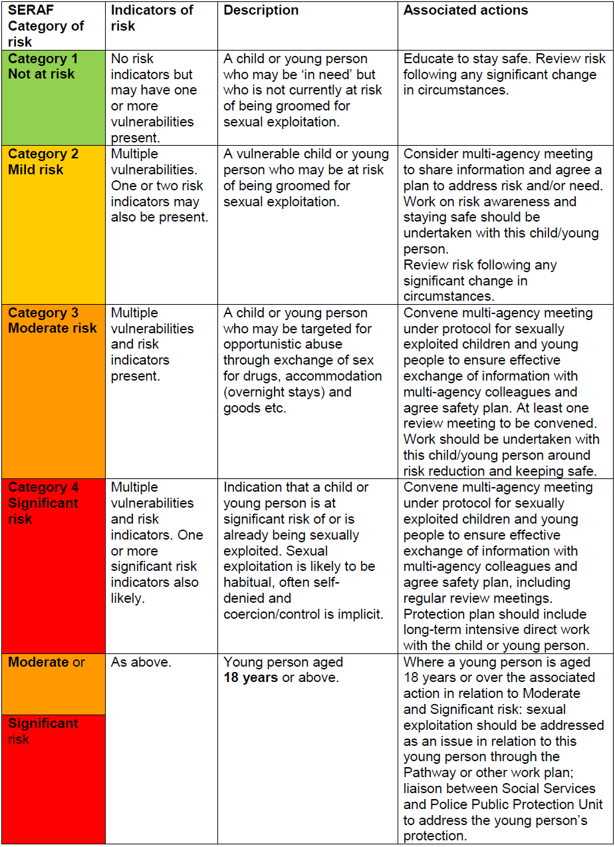
Notes:
Need to include 'health warning' - the SERAF was developed from data and research gathered in relation to children and young people who were overwhelming British born and had not been trafficked from abroad. The weighted matrix depends on information that will not be available in the majority of cases when applied to a child who has trafficked from abroad- e.g. family vulnerabilities - domestic abuse, parental mental health, parental substance misuse, risk factors such as missing from school, staying out late, use of the internet that causes concern. It may be possible to apply to a child who is accommodated after being identified as a victim of trafficking from abroad. If a child identified as a victim of trafficking they could potentially score as on the basis of significant risk indicators e.g. controlling adult. physical abuse by controlling adult would give a score of 15 (moderate risk) - they would need expressions of despair, alcohol abuse for example in addition to get 16 or above and a significant risk score. The point is the confidence of the tool in relation to children that are not known to services such as education, health, social care, police is weaker. Delegates should be made aware of this.
If there are children from outside of the UK being exploited, the toolkit can be used, but with caution.

Slide 34
CASE STUDIES
Using the Sexual Exploitation Risk Assessment Framework (SERAF), risk assess Nathan or Hayley & then answer the following questions:
What information/intelligence could you pass on regarding Nathan or Hayley?
What course of action would you take?
Notes:
They should inform you in question 2 that they will inform their manager of the outcome of the SERAF and arrange a multi-agency meeting to agree a safety plan & way forward.
You will tell them that as their manager you don’t feel that’s necessary & aren’t willing to sanction a multi agency meeting.
Now what will they do?
Ultimately the responsibility lies with the safeguarding lead & they have to evidence their decision.

Slide 35
WHO CAN HELP?
Barnardo’s Cymru
Regional Safeguarding Children Board
NSPCC
Care Council for Wales
Children’s Commissioner for Wales
Notes:
In the event of completing a SERAF & refusal by a line manager to call a multi-agency meeting (in line with AWCPP), then you should follow your internal procedures & take it to the next manager up in the chain of command.
If you exhaust your procedures & a child is still at risk then you should approach the above in order, e.g. Barnardos first to support the assessment outcome, etc.

Slide 36
KEY ISSUES AND PRINCIPLES:
Children are victims not criminals
A multi-agency response is crucial
Actions are needed to support a proactive response and early intervention
The need for a child centred approach
The need to work with families
The need to protect ALL children and young people- including 16 and 17 year olds
Notes:
Remind about BOYS too.

Slide 37
NATIONAL REFERRAL MECHANISM (NRM)?
Has the exploited child or young person also been trafficked?
Child Protection procedures still apply
You must now ensure that the NRM form is completed by a First Responder
Contact your local Children’s Social Services specifically highlighting your concern for child trafficking
Pass intelligence to your SPOC (single point of contact) for Operation Eagle within your Police Area.
Notes:
Show a copy of the NRM form for children and remind those who are first responders to complete the Wales Anti-Slavery First Responder Training Course.
REMIND - Slavery: Is when people are moved from one place to another to be exploited.
This does not have to be long distances.
It could be from one room to another, one floor to another, one building to another, one city to another, one country to another.
All cases which score moderate or high risk on the SERAF model and have a slavery element a NRM form MUST be completed.
N.B. There is no consent needed for the completion of an NRM form for a child.

Slide 38
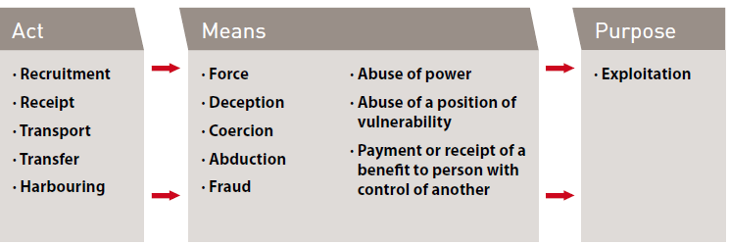

CONSTITUENT ELEMENTS FOR TRAFFICKING
Notes:
Child trafficking = Act & purpose only
Forced Labour = Means & Service. Service means as a result of the means an individual provides a service for benefit, e.g. begging, sexual services, manual labour & domestic service
Child forced labour = service only
Give Definition of trafficking from UN Trafficking in Persons Protocol.
The principal difference between people smuggling and human trafficking is the element of exploitation. It is important to examine the end situation when the victim is recovered to determine whether they have been smuggled or trafficked.
Victims of trafficking have not consented, or the consent they did give is rendered meaningless by the actions of the traffickers, e.g. deception. However, for those who have been trafficked the very purpose of their journey is to put them into an exploitation situation from which the traffickers can profit. Human trafficking can be categorised as sexual exploitation (rape and prostitution) and non-sexual exploitation (begging, forced labour, domestic servitude, cannabis cultivation, pick-pocketing, human organ transplant, slavery)
People being smuggled as illegal migrants have usually consented to being smuggled. The relationship between an illegal migrant and a people smuggler is a commercial transaction which ends on completion of the journey.

Slide 39
FIRST RESPONDERS IN WALES
Police & British Transport Police
UK Border Force
Home Office Immigration and Visas
Gangmasters Licensing Authority
Local Authorities
Health
Salvation Army
BAWSO
Barnardos
New Pathways
NSPCC
Notes:
The person completing the referral form is known as the first responder
Introduced in 2009 to ensure we’re meeting EU regulations on slavery
Consent needed to put in NRM form
Best for NRM form to be completed by the First Responder so that the quality of information provided meets the required criteria for the 45 day period.

Slide 40
WHAT CAN HELP?
The following Orders, Warnings and Notices can be used to help disrupt the exploitation of children and young people:
The Magistrates’ Courts Rules 2004:
Sexual Harm Prevention Orders and Sexual Risk Orders were introduced by the Anti-Social Behaviour, Crime and Policing Act 2014. They replace the previous Sexual Offences Prevention Orders, Risk of Sexual Harm Orders and Foreign Travel Orders which were introduced by the Sexual Offences Act 2003.
Harassment Warnings (Police Information Notices) – see also ACPO (2009) Practice Advice on Stalking and Harassment
Anti-social Behaviour Act 2003
Child Abduction Warning Notices (formerly known as Harbourer’s Warning Notices)
Police protection – s 46 of the Children Act 1989.
Notes:
. Sexual Harm Prevention Orders can be applied to anyone convicted or cautioned for a sexual or violent offence, including where offences are committed overseas. They will replace Sexual Offences Prevention Orders and Foreign Travel Orders; and
Sexual Risk Orders can be applied to any individual who poses a risk of sexual harm in the UK or abroad, even if they have never been convicted. They will replace the Risk of Sexual Harm Order.
Range of restrictions
Both powers can place a range of restrictions on individuals depending on the nature of the case, such as limiting their internet use, preventing them from being alone with a child under 16, or preventing travel abroad.
The Sexual Harm Prevention Order can be made by a court on conviction, or if the police or National Crime Agency (NCA) apply to a magistrates’ court. The order lasts a minimum of five years and has no maximum duration.
The Sexual Risk Order can be made if the police or NCA apply to a magistrates’ court regarding a person who poses a risk of sexual harm. It lasts a minimum of two years and has no maximum duration.
Sexual Harm Prevention Orders and Sexual Risk Orders were introduced by the Anti-Social Behaviour, Crime and Policing Act 2014. They replace the previous Sexual Offences Prevention Orders, Risk of Sexual Harm Orders and Foreign Travel Orders which were introduced by the Sexual Offences Act 2003.
Sexual Risk Orders can be made where a person has done an act of a sexual nature as a result of which there is reasonable cause to believe that it is necessary for such an order to be made, even if they have never been convicted. They replace the previous Risk of Sexual Harm Orders.
The court needs to be satisfied that the order is necessary for protecting the public, or any particular members of the public, from sexual harm from the defendant; or protecting children or vulnerable adults generally, or any particular children or vulnerable adults, from sexual harm from the defendant outside the United Kingdom.
The Orders prohibit the defendant from doing anything described in the order, and can include a prohibition on foreign travel (replacing Foreign Travel Orders which were introduced by the Sexual Offences Act 2003).
A prohibition contained in a Sexual Risk Order has effect for a fixed period, specified in the order, of not less than 2 years, or until further order. The Order may specify different periods for different prohibitions.
Failure to comply with a requirement imposed under an Order is an offence punishable by a fine and/or imprisonment.

Slide 41
PERPETRATORS
IDENTIFYING AND PROSECUTING
Linking prosecutions to the provision of support
Taking action against perpetrators
Disrupting perpetrator behaviour
Identifying offences committed
Identifying individual perpetrators
Tackling child sex offender or organised criminal networks
Evidence gathering and information sharing
National Offender Management Service
Multi-Agency Public Protection Arrangements (MAPPA)
Notes:
To combat increasing sexual approaches to children on-line, there is a new offence of meeting a child following sexual grooming. This makes it a crime to befriend a child on the Internet or by other means and meet or intend to meet the child with the intention of abusing them. The maximum sentence is 10 years imprisonment.
A new civil preventative order, the Risk of Sexual Harm Order, may be imposed which will prohibit adults from engaging in inappropriate behaviour such as sexual conversations with children on-line.

Slide 42
WHAT WENT WRONG…..
In Rotherham, Rochdale & Oxford:
Wilful blindness describes the failures of individuals and agencies to tackle CSE in these towns and cities.
Wilful blindness is knowledge you could have, and should have had, but chose not to seek out.
DON’T LET IT HAPPEN IN WALES

Slide 43
LESSONS LEARNED
Operation Pallial
Police and Crime Commissioner South Wales CSE recommendations
England Serious Case Review – Operation Bullfinch (Oxford)
Notes:
Handout with links to these if people want to read them.
Explain that the lessons to be learnt from these reports have been incorporated in to this training.

Slide 44
WAY FORWARD…
Consistent child –centred response to Child Exploitation across Wales
Effective multi-agency working and information sharing
Effective use of the Wales Care Pathway: All Wales Child Protection Procedures; MARAC
Wales National Action Plan in place for child sexual exploitation to support a robust and consistent response to this form of abuse across Wales.
Notes:
National Action Plan in place with a set of minimum standards that will need to be achieved & adhered to.

Slide 45
ALL AGENCIES MUST:
Ensure that staff are aware of CSE and the risk indicators;
Provide training as part of a rolling programme;
Ensure that staff are familiar with the local protocol & operational handbook on child trafficking and know who the lead person in their agency is;
Ensure that staff are made aware of local referral procedures where there is a concern related to CSE
Support staff in identifying the ways in which their skills and working practices can support identification, prevention, early intervention and appropriate responses to risk of abuse through CSE.
Notes:
Remind delegates about the Operational Handbook for child trafficking.

Slide 46
OUR AIM
To make Wales safe for children by:
Making Wales hostile for perpetrators
Children and young people protected from abuse
Improved understanding of the scale of the issue
Improving the recovery rate for young people who are going missing
Increased prosecutions of criminals
Improved multi-agency working and information sharing.

Slide 47
CHILD SEXUAL EXPLOITATION AND SLAVERY IS CHILD ABUSE

Slide 48
LEARNING OUTCOMES
What will you take away from today’s session?
What will you do differently?
Establish what your local strategy is for the SERAF process and raising issues of CSE.
Notes:
Give handouts of AWCPP handout on CSE expectations, CSE Barnardos leaflet and messages for practice.

